Slide 1
1.1 Number systems
Converting between number systems – Part 1

Slide 2

About denary
0
1
= Binary Digit

Slide 3
About denary
0
1
2
3
4
5
0
1
6
7
8
= Binary Digit
9

Slide 4
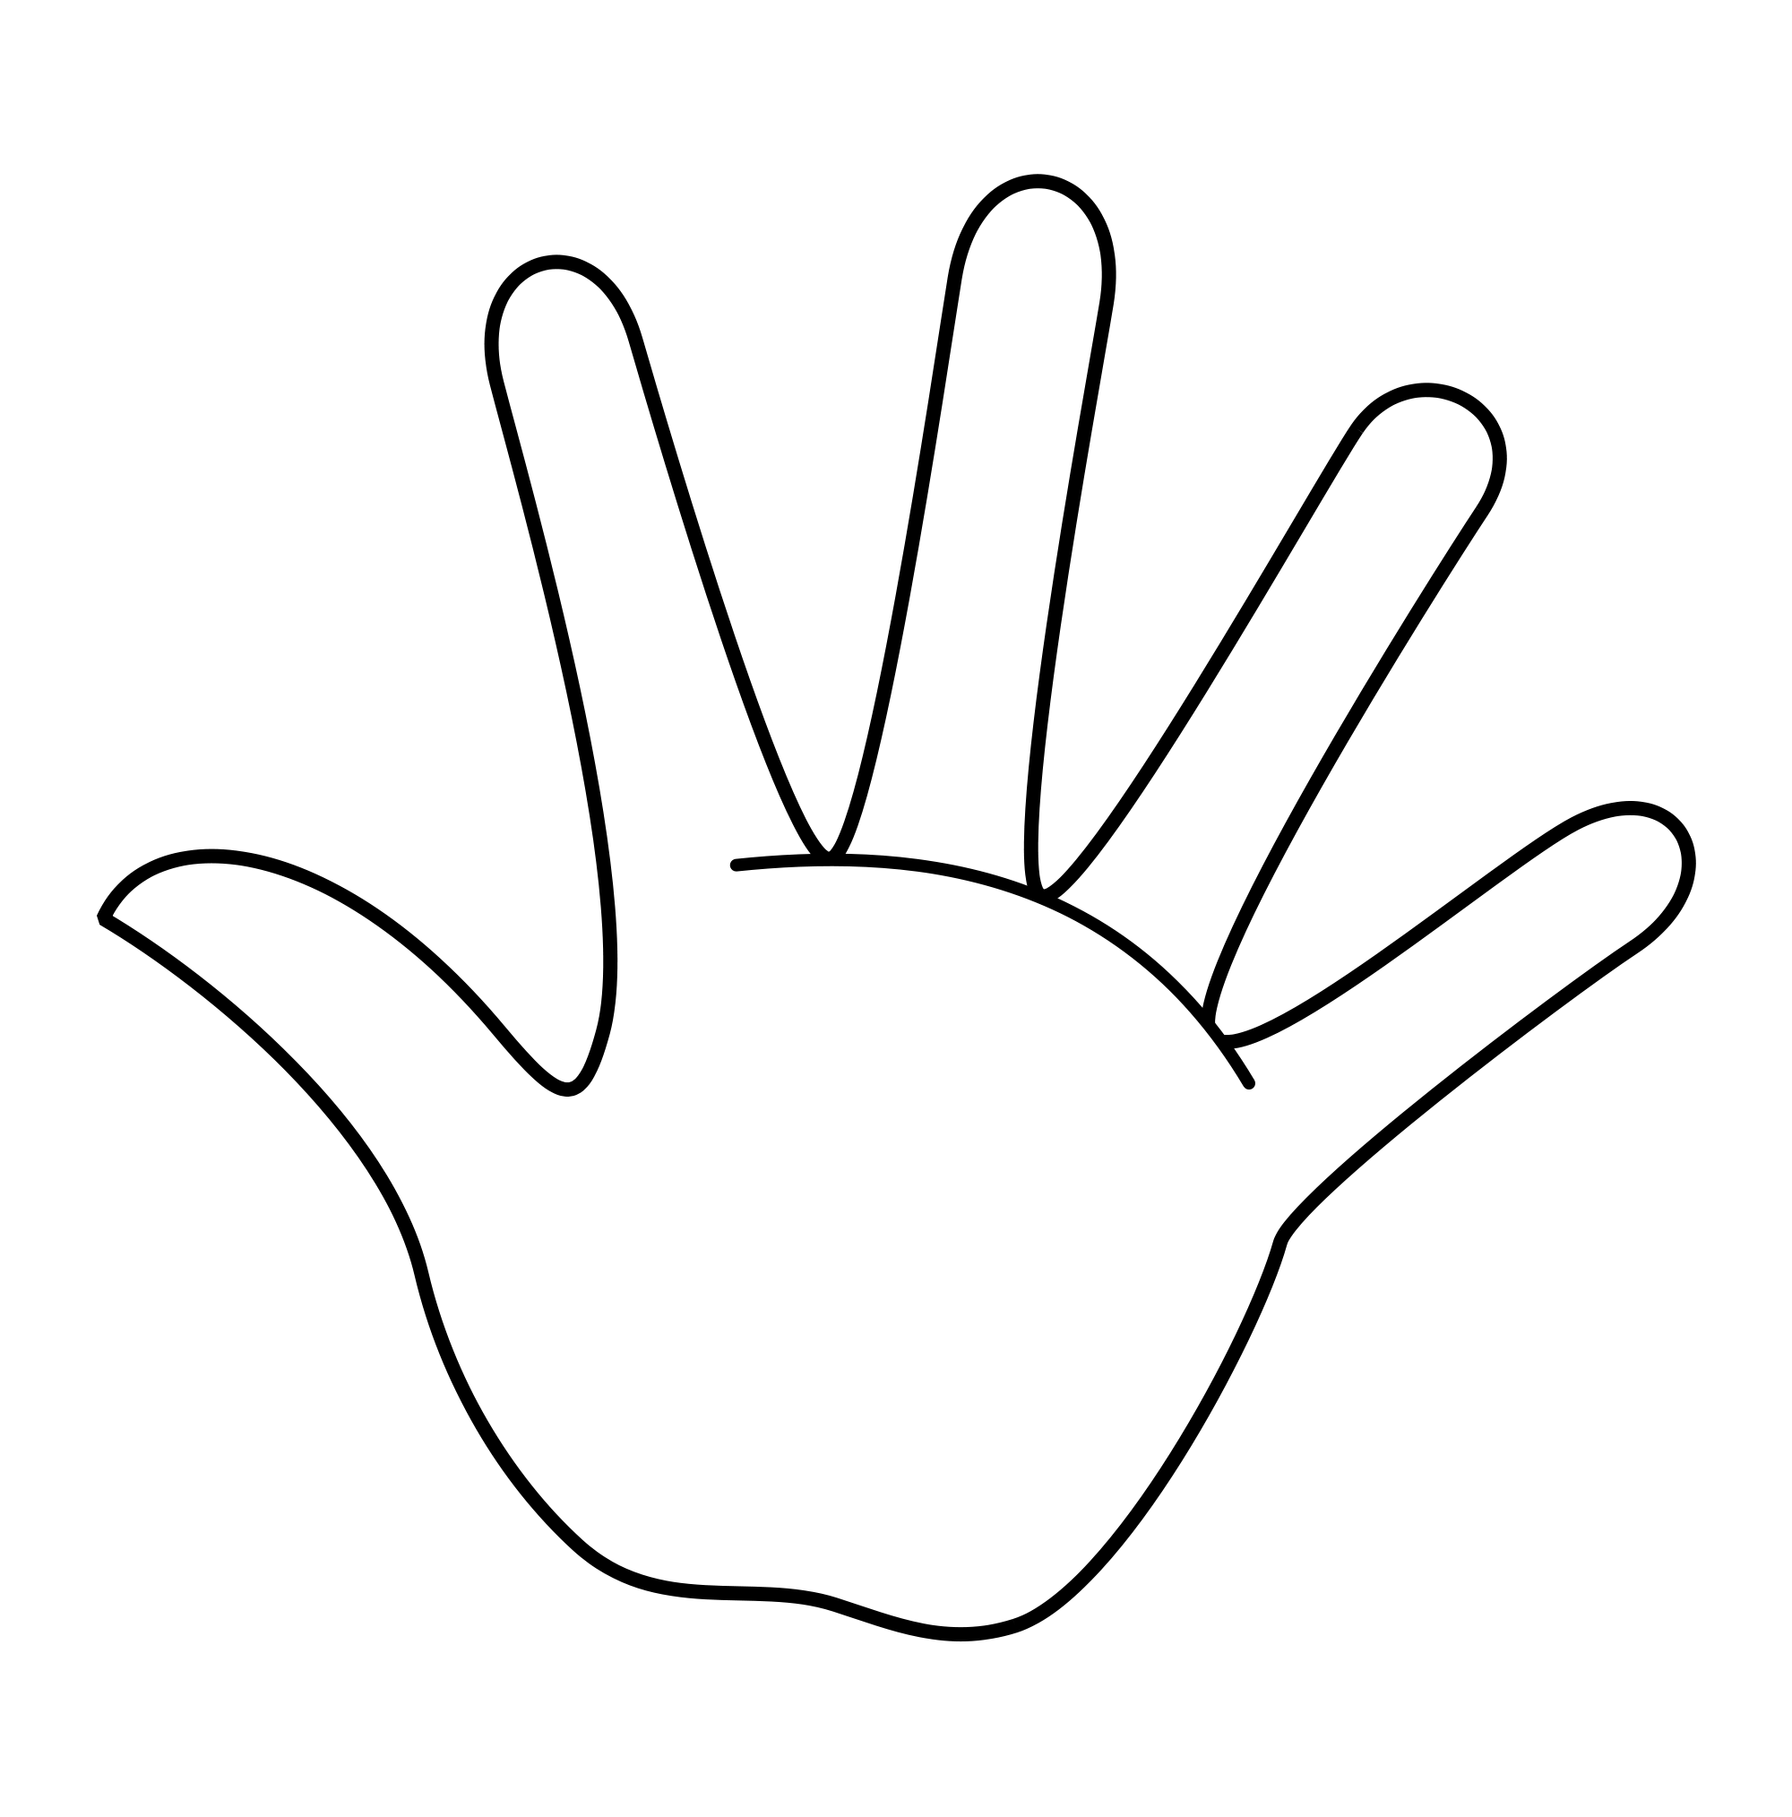
About denary
0
1
2
3
4
5
0
1
6
7
8
= Binary Digit
9

Slide 5
About denary
100s | 10s | 1s
0 | 1 | 0

Slide 6
About denary
100s | 10s | 1s
0 | 1 | 0
0 × 100 | 1 × 10 | 0 × 1
+
+
= 10

Slide 7
About denary
100s | 10s | 1s
0 | 8 | 9
0 × 100 | 8 × 10 | 9 × 1
+
+
= 89

Slide 8
About binary
4s | 2s | 1s
0 | 1 | 1

Slide 9
About binary
4s | 2s | 1s
0 | 1 | 1
0 × 4

Slide 10
About binary
4s | 2s | 1s
0 | 1 | 1
0 × 4 | 1 × 2
+

Slide 11
About binary
4s | 2s | 1s
0 | 1 | 1
0 × 4 | 1 × 2 | 1 × 1
+
+
= 3

Slide 12
About binary
4s | 2s | 1s
0 | 1 | 1
0 × 4 | 1 × 2 | 1 × 1
+
+
= 3

Slide 13
Denary to binary
There are two main methods you can use to convert from denary to binary:
Method 1
Divide-by-two
Method 2
Binary number line
Both are equally as valid, so use whichever you feel most comfortable with.

Slide 14
Denary to binary: Divide-by-two method
Convert the denary number 89 into binary
Divisions by 2 | Remainder

Slide 15
Denary to binary: Divide-by-two method
Convert the denary number 89 into binary
Divisions by 2 | Remainder
89 | 1
44

Slide 16
Denary to binary: Divide-by-two method
Convert the denary number 89 into binary
Divisions by 2 | Remainder
89 | 1
44 | 0
22

Slide 17
Denary to binary: Divide-by-two method
Convert the denary number 89 into binary
Divisions by 2 | Remainder
89 | 1
44 | 0
22 | 0
11

Slide 18
Denary to binary: Divide-by-two method
Convert the denary number 89 into binary
Divisions by 2 | Remainder
89 | 1
44 | 0
22 | 0
11 | 1
5

Slide 19
Denary to binary: Divide-by-two method
Convert the denary number 89 into binary
Divisions by 2 | Remainder
89 | 1
44 | 0
22 | 0
11 | 1
5 | 1
2

Slide 20
Denary to binary: Divide-by-two method
Convert the denary number 89 into binary
Divisions by 2 | Remainder
89 | 1
44 | 0
22 | 0
11 | 1
5 | 1
2 | 0
1

Slide 21
Denary to binary: Divide-by-two method
Convert the denary number 89 into binary
Divisions by 2 | Remainder
89 | 1
44 | 0
22 | 0
11 | 1
5 | 1
2 | 0
1 | 1
0

Slide 22
Denary to binary: Divide-by-two method
Convert the denary number 89 into binary
Divisions by 2 | Remainder
89 | 1
44 | 0
22 | 0
11 | 1
5 | 1
2 | 0
1 | 1

Slide 23

Denary to binary: Divide-by-two method
Convert the denary number 89 into binary
Divisions by 2 | Remainder
89 | 1
44 | 0
22 | 0
11 | 1
5 | 1
2 | 0
1 | 1
 | 0
= 01011001

Slide 24
Denary to binary: Binary number line method
Convert the denary number 89 into binary
128 | 64 | 32 | 16 | 8 | 4 | 2 | 1

Slide 25
Denary to binary: Binary number line method
Convert the denary number 89 into binary
89
128 | 64 | 32 | 16 | 8 | 4 | 2 | 1
0

Slide 26
Denary to binary: Binary number line method
Convert the denary number 89 into binary
89 - 64 = 25
128 | 64 | 32 | 16 | 8 | 4 | 2 | 1
0 | 1

Slide 27
Denary to binary: Binary number line method
Convert the denary number 89 into binary
89 - 64 = 25
128 | 64 | 32 | 16 | 8 | 4 | 2 | 1
0 | 1 | 0

Slide 28
Denary to binary: Binary number line method
Convert the denary number 89 into binary
89 - 64 = 25 - 16 = 9
128 | 64 | 32 | 16 | 8 | 4 | 2 | 1
0 | 1 | 0 | 1

Slide 29
Denary to binary: Binary number line method
Convert the denary number 89 into binary
89 - 64 = 25 - 16 = 9 - 8 = 1
128 | 64 | 32 | 16 | 8 | 4 | 2 | 1
0 | 1 | 0 | 1 | 1

Slide 30
Denary to binary: Binary number line method
Convert the denary number 89 into binary
89 - 64 = 25 - 16 = 9 - 8 = 1
128 | 64 | 32 | 16 | 8 | 4 | 2 | 1
0 | 1 | 0 | 1 | 1 | 0

Slide 31
Denary to binary: Binary number line method
Convert the denary number 89 into binary
89 - 64 = 25 - 16 = 9 - 8 = 1
128 | 64 | 32 | 16 | 8 | 4 | 2 | 1
0 | 1 | 0 | 1 | 1 | 0 | 0

Slide 32
Denary to binary: Binary number line method
Convert the denary number 89 into binary
89 - 64 = 25 - 16 = 9 - 8 = 1
128 | 64 | 32 | 16 | 8 | 4 | 2 | 1
0 | 1 | 0 | 1 | 1 | 0 | 0 | 1
= 01011001

Slide 33
Denary to binary: Binary number line method
Convert the denary number 89 into binary
89 - 64 = 25 - 16 = 9 - 8 = 1
128 | 64 | 32 | 16 | 8 | 4 | 2 | 1
0 | 1 | 0 | 1 | 1 | 0 | 0 | 1
 | 64 |  | 16 | 8 |  |  | 1
= 01011001
+
+
= 89
+

Slide 34
Binary to denary
Convert the binary number 01100110 into denary
128 | 64 | 32 | 16 | 8 | 4 | 2 | 1

Slide 35
Binary to denary
Convert the binary number 01100110 into denary
128 | 64 | 32 | 16 | 8 | 4 | 2 | 1
0 | 1 | 1 | 0 | 0 | 1 | 1 | 0

Slide 36
Binary to denary
Convert the binary number 01100110 into denary
128 | 64 | 32 | 16 | 8 | 4 | 2 | 1
0 | 1 | 1 | 0 | 0 | 1 | 1 | 0
 | 64 | 32 |  |  | 4 | 2
+
+
+
+
= 102

Slide 37
Number bases: Binary (base 2)
The maximum binary number length you will get in your exam is 16 bits – this means:
The smallest positive whole number you can represent will be 0.
The largest positive whole number you can represent will be 65,535.
32,768 | 16,384 | 8,192 | 4,096 | 2,048 | 1,024 | 512 | 256 | 128 | 64 | 32 | 16 | 8 | 4 | 2 | 1
0 | 0 | 0 | 0 | 0 | 0 | 0 | 0 | 0 | 0 | 0 | 0 | 0 | 0 | 0 | 0
1 | 1 | 1 | 1 | 1 | 1 | 1 | 1 | 1 | 1 | 1 | 1 | 1 | 1 | 1 | 1
= 0
= 65,535

Slide 38


